Slide 1


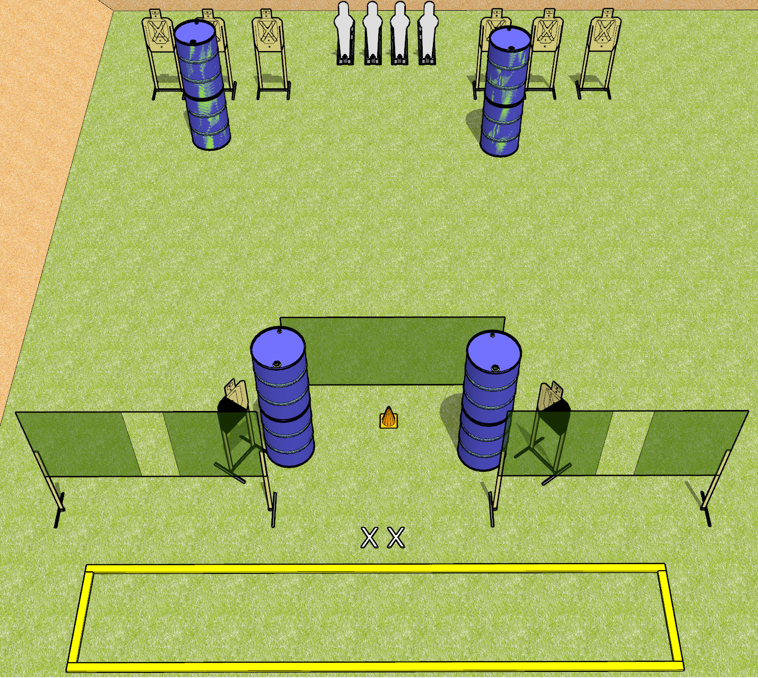
 | Dothan Gun Club – USPSA Match Don’t Shoot Twice Course Designer : Drew Coleman
START POSITION : Standing with both feet on X's, outside the shooting area
GUN READY CONDITION : Pistol loaded and holstered. PCC shouldered, safety on, pointed at orange cone. |  | SCORING: Comstock, 20 rounds TARGETS: 8 paper, 4 Steel SCORED HITS: Best 2 on paper, steel until down START-STOP: Audible, last shot RULES:
STAGE PROCEDURE: Engage targets as they become available from within the fault lines.

Slide 2
Notes
Don’t Shoot Twice
Rear paper are T1 through T6, left to right and should only be engaged from the ports
Only T1, T3, T4, and T6 + poppers should be able to be engaged from the left port
Only T2, T3, T5, and T6 + poppers should be able to be engaged from the right port
Poppers should be 27 feet from ports and only be engaged from the ports

